Slide 1

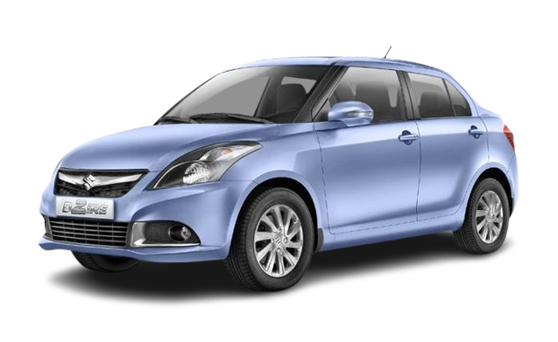
Online Vehicle Management System

Slide 2

Introduction
The Vehicle Management System is an online platform designed to facilitate the selling of vehicles efficiently. This system is developed using Java and aims to provide users with a seamless experience in browsing, selecting, and purchasing vehicles.
It serves as a bridge between vehicle sellers and buyers, ensuring a secure and user-friendly transaction process. The System helps sellers list their vehicles with detailed information, and buyers can browse, compare, and purchase vehicles effortlessly.
Traditionally, buying or selling a vehicle requires visiting showrooms, negotiating prices, and dealing with paperwork. This system simplifies all these process and by eliminating the need for physical visits, this system makes the entire process faster, more efficient, and accessible to a wider audience.

Slide 3
Scope of System
Scope of Online Vehicle Management System is a web based platform designed to help people buy vehicles easily. It allows sellers to list their vehicles with details such as price, images, and specifications, while buyers can search for and compare different vehicles before making a purchase. The system provides a user-friendly interface where transactions can be done securely without needing to visit physical showrooms.
The platform is built using Java, JSP, PostgreSQL and Apache Tomcat, making it a reliable and scalable system. Administrators manage the platform by verifying vehicle listings, monitoring transactions, and ensuring smooth operations.

Slide 4
Existing System
Traditional Buying & Selling – People buy and sell vehicles through physical showrooms or local advertisements.
Limited Reach – Sellers can only connect with buyers in their local area.
Time-Consuming Process – Buyers need to visit multiple locations to find the right vehicle.
Manual Transactions – Payments and paperwork are mostly done offline, which can be slow.
Lack of Proper Filtering – Finding a vehicle with specific features requires more effort.
Higher Costs – Seller spend money on advertisements, and buyers may pay extra due to middlemen.
No Centralized System – No single platform where buyers and sellers can interact easily.
Limited Reach – No proper verification of vehicle details or seller authenticity.

Slide 5
Proposed System
The aim of Proposed System is to develop a system of improved facilities. The Proposed System can overcome all the limitations of the Existing System. The Existing System has several disadvantages and many more difficulties to work well. The Proposed System tries to eliminate or reduce these difficulties up to some extent. The Proposed System will help the user to reduce the workload and mental conflict.
The Proposed Online Vehicle Management System provide a user-friendly and efficient platform for buying and selling vehicles online. With this system, the vehicle buying and selling process becomes more convenient, cost effective, and secure, eliminating the need for intermediaries and reducing transaction time.

Slide 6
Hardware & Software Requirements
Hardware Requirement
Processor | Intel Core i3
RAM | 8.00 GB
SSD | 512 GB
Software Requirement
Operating System | Windows 11
Frontend | HTML,CSS,Bootstrap & JavaScript
Backend | Java ( JSP & Servlets)
Database | PostgreSQL
Server | Apache Tomcat
Browsers | Google Chrome,Mozilla Firefox

Slide 7
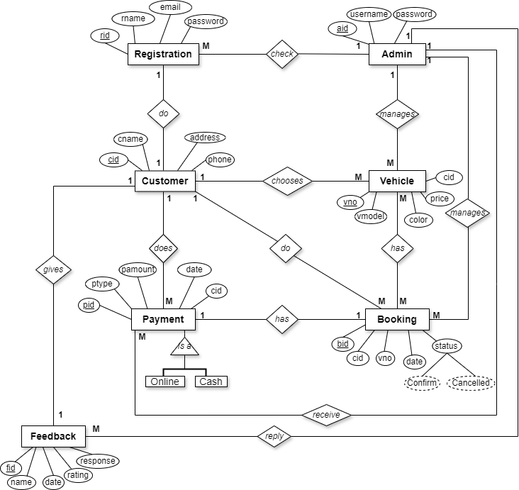

ER Diagram

Slide 8
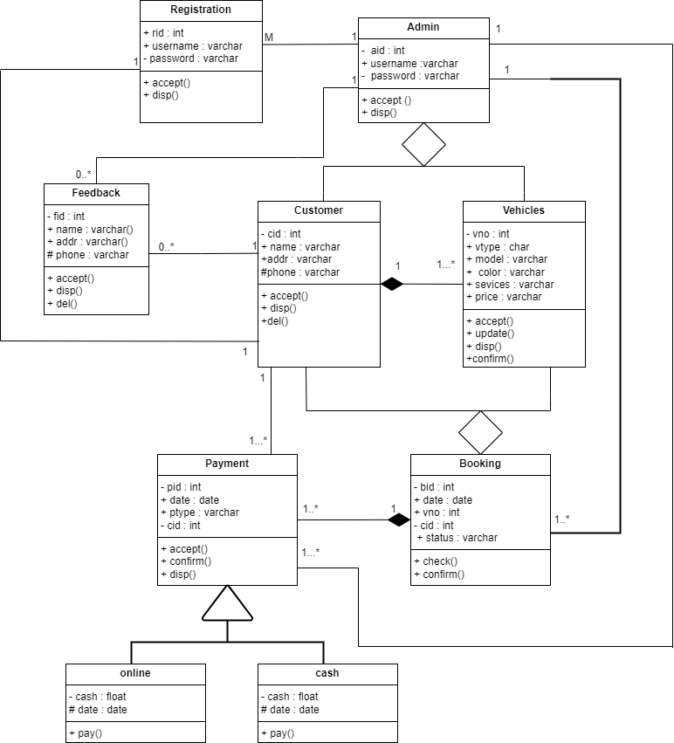
Class Diagram

Slide 9
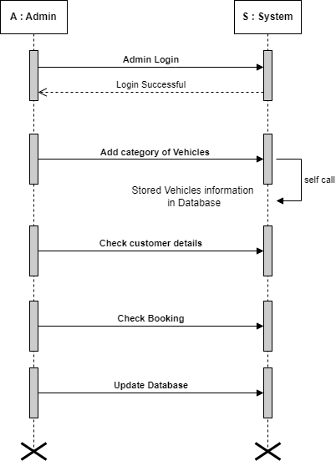
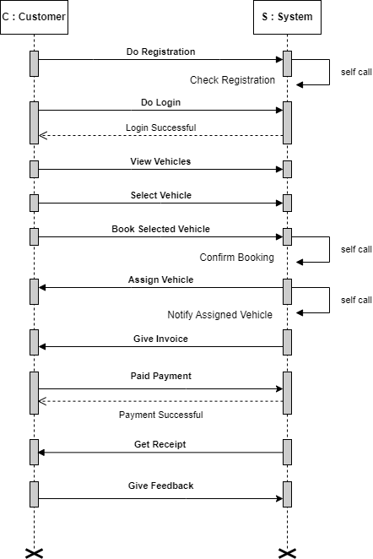
Sequence Diagram

Slide 10
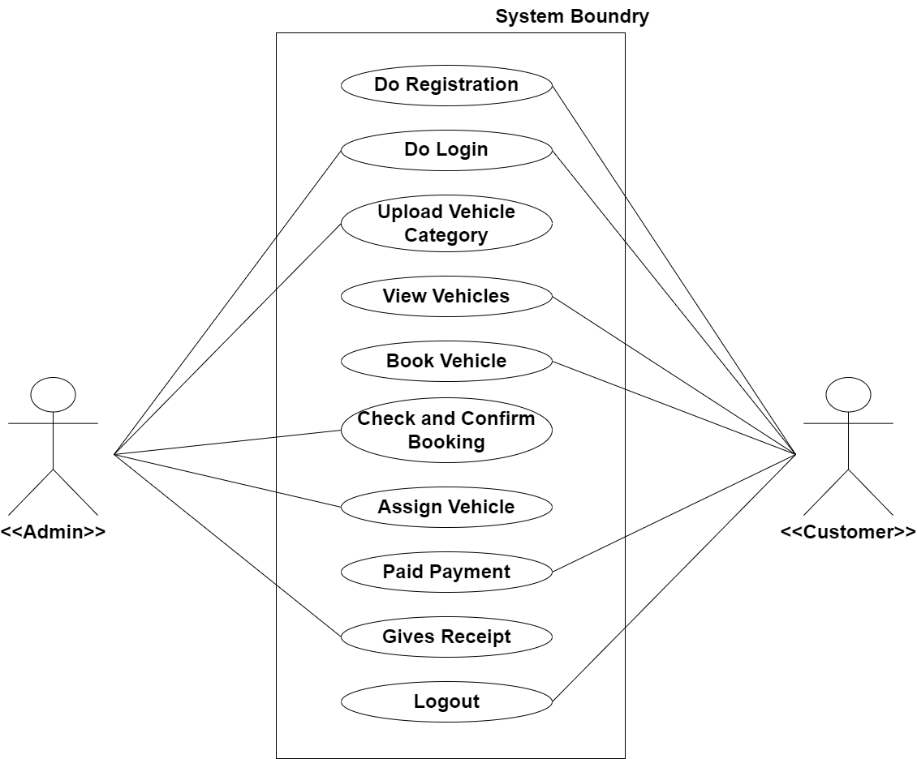
Usecase Diagram

Slide 11
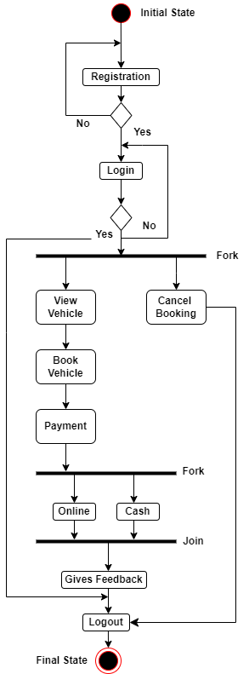
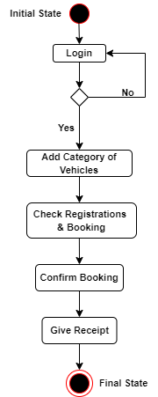
Activity Diagram

Slide 12
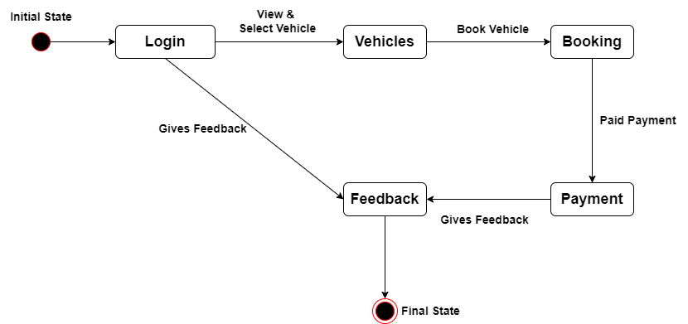
State-Chart Diagram

Slide 13
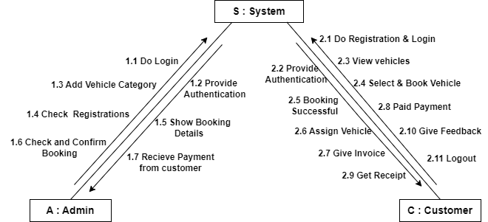
Collaboration Diagram

Slide 14
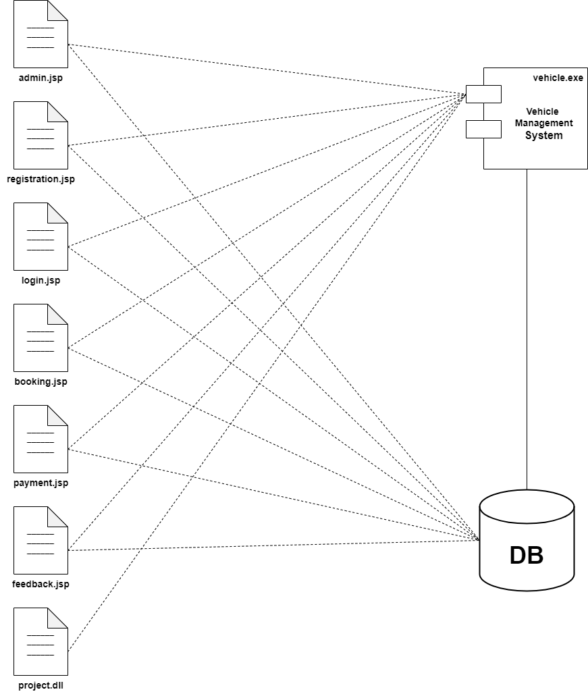
Component Diagram

Slide 15
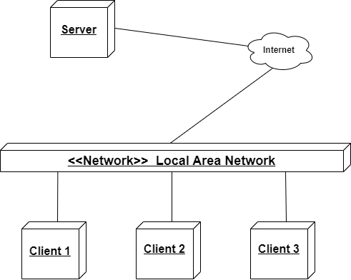
Deployment Diagram

Slide 16
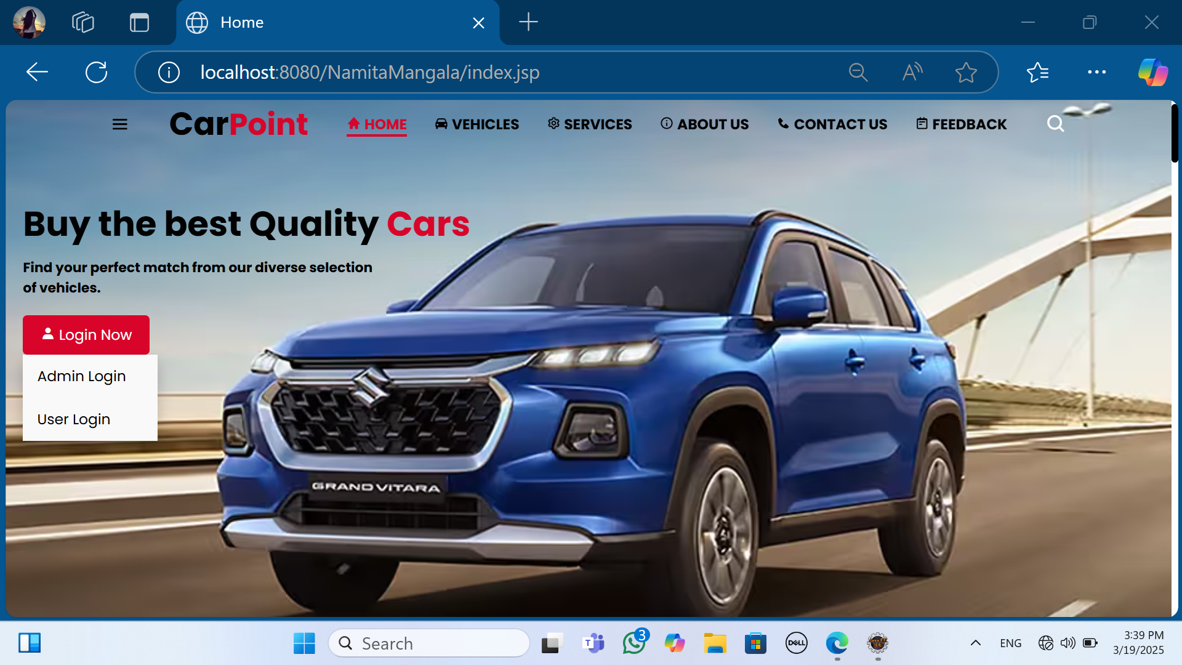
Home Page

Slide 17
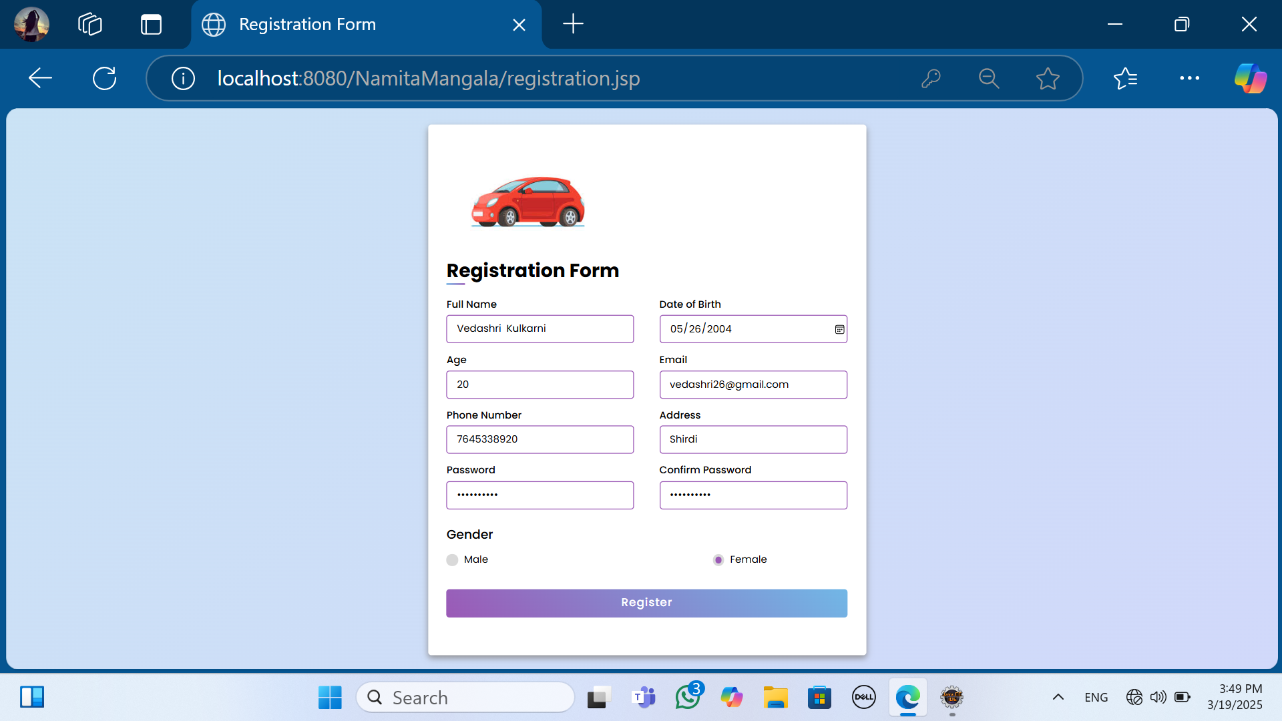
Registration Form

Slide 18
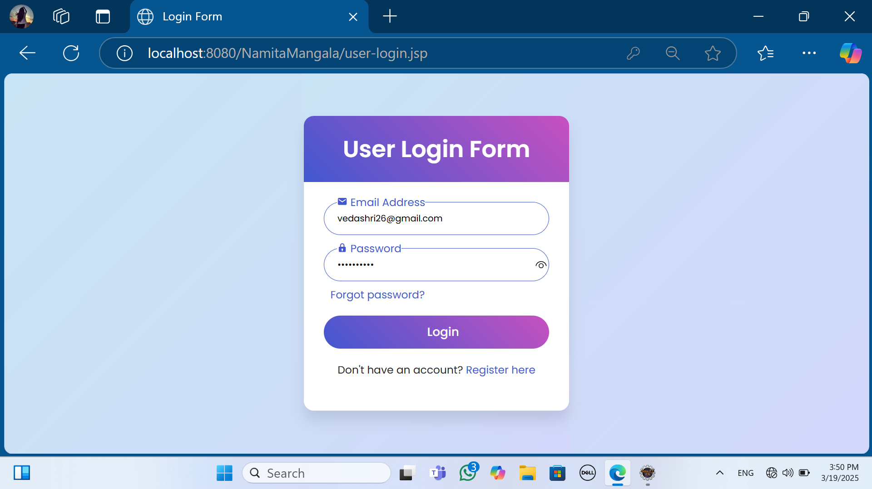
User Login Form

Slide 19
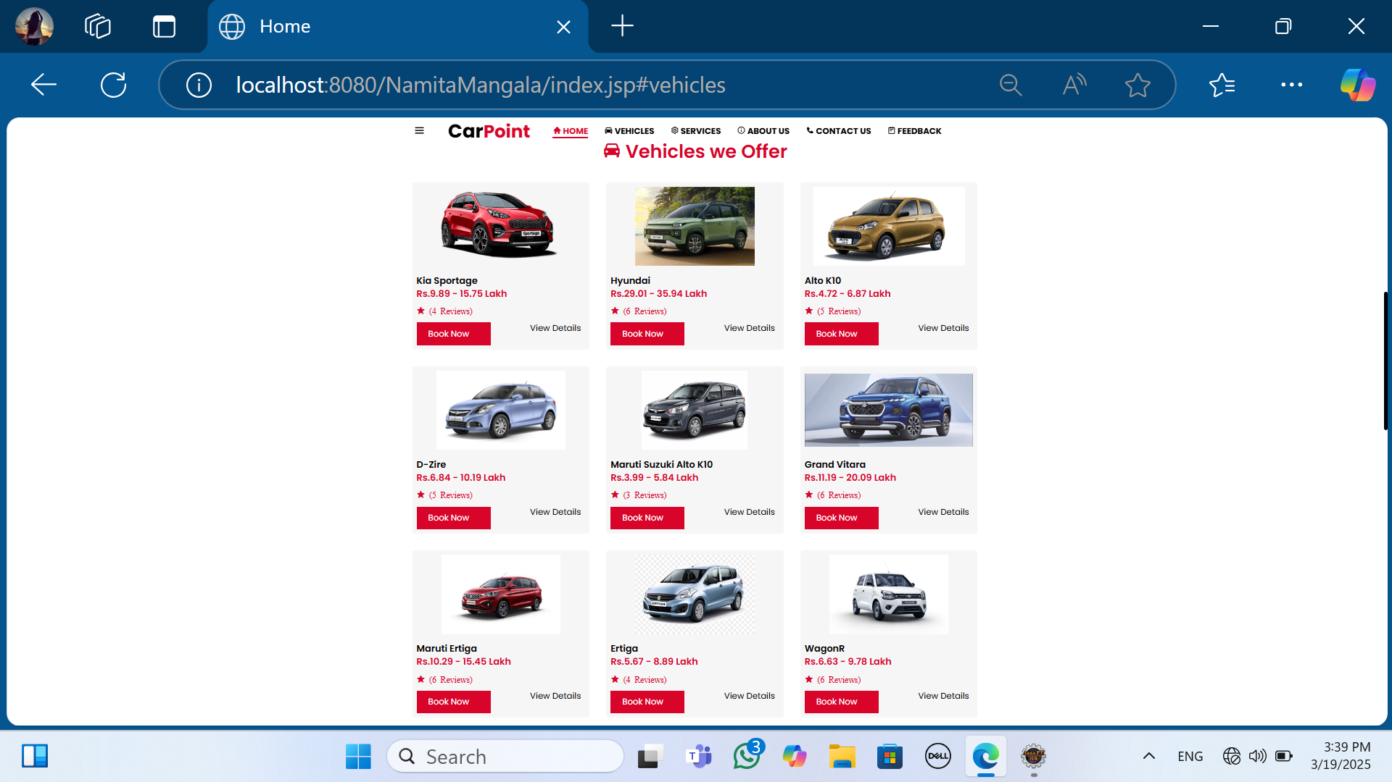
Vehicles Page

Slide 20
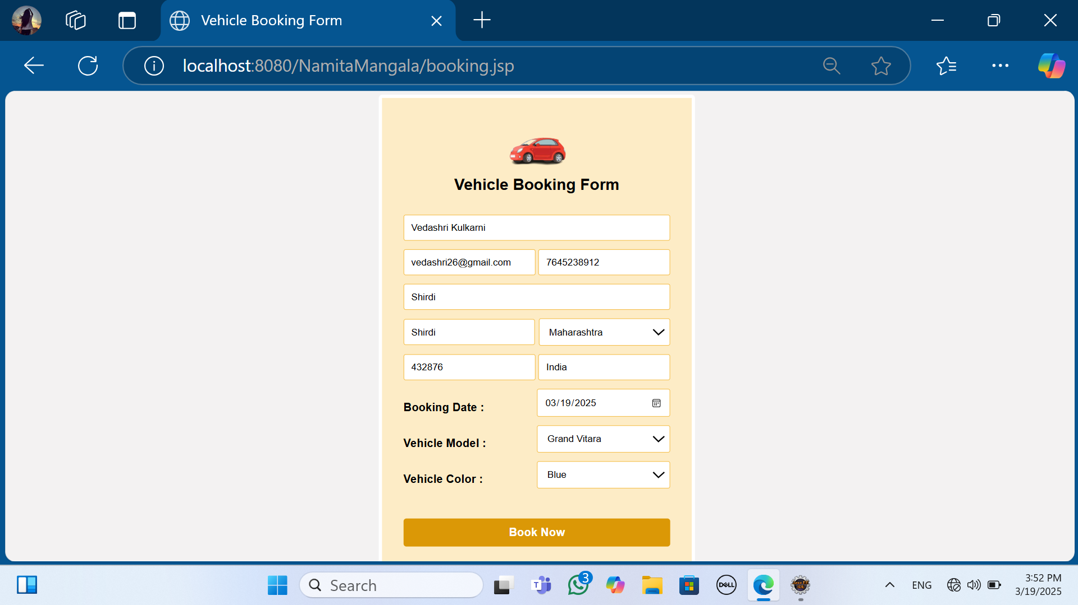
Vehicle Booking Form

Slide 21
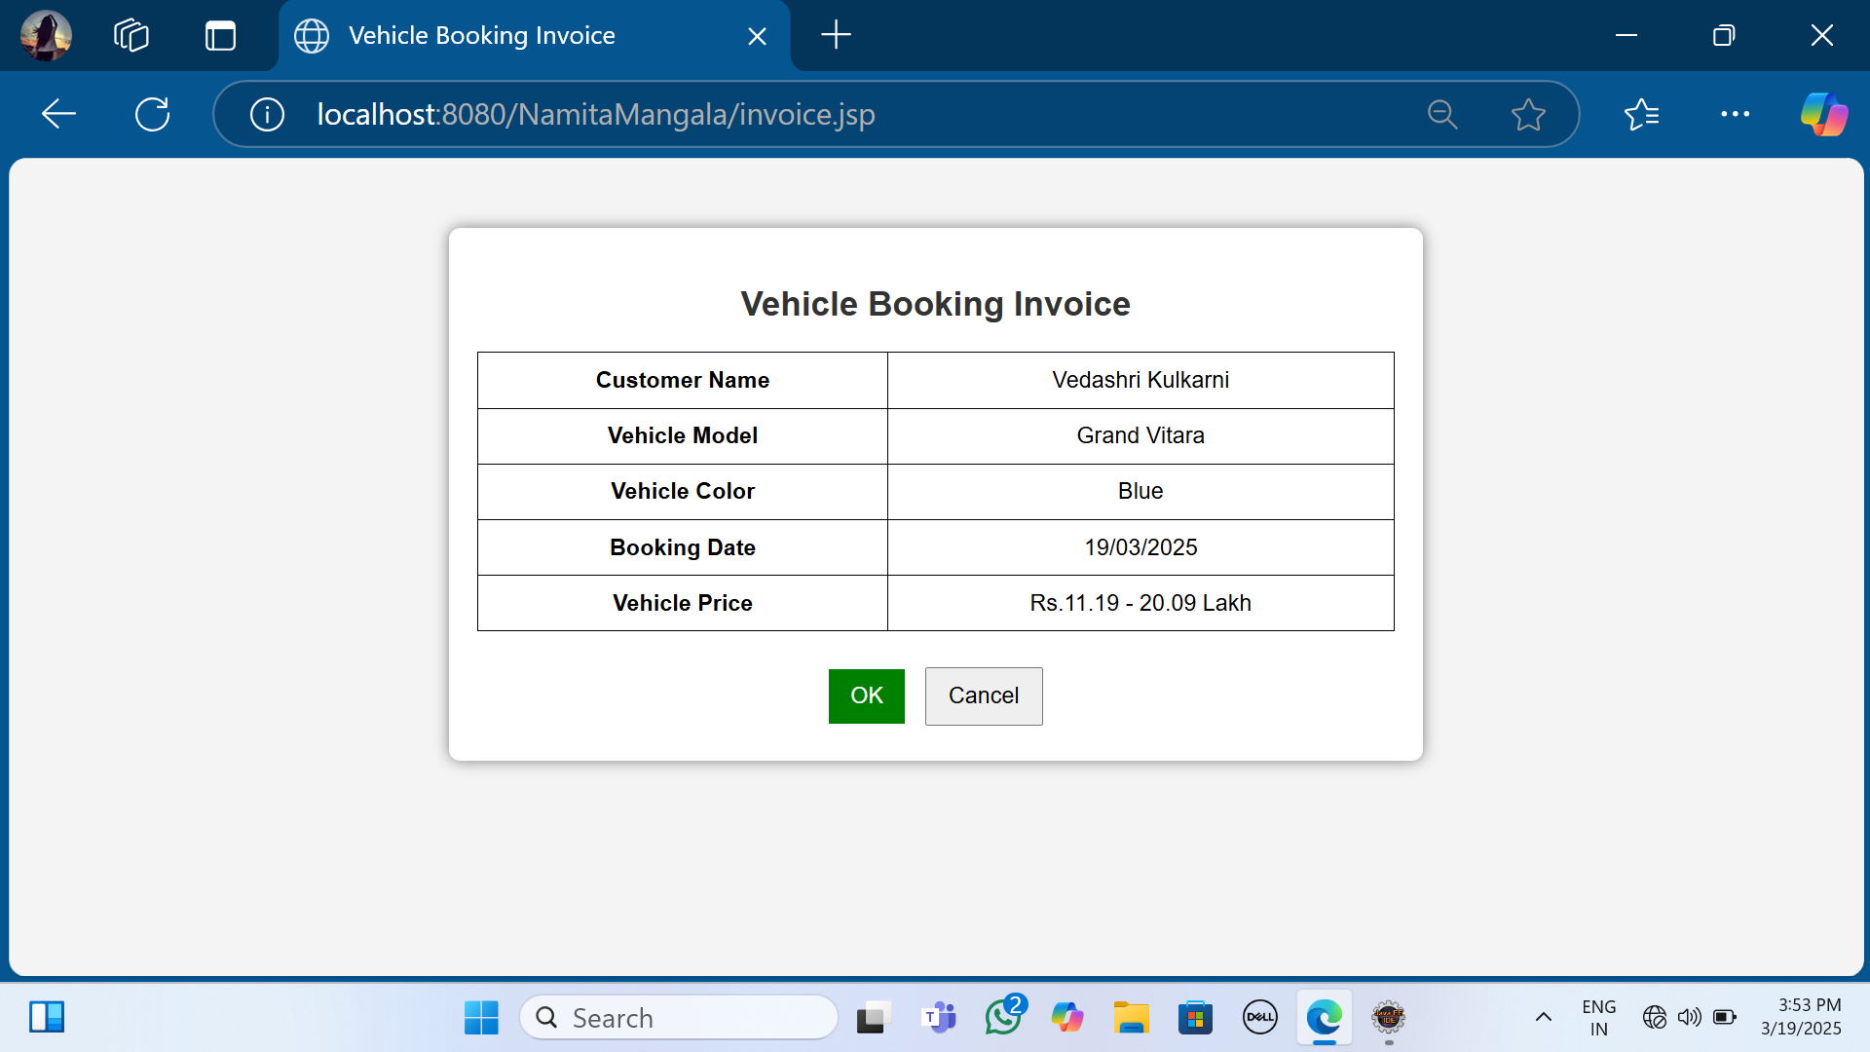
Vehicle Booking Invoice

Slide 22
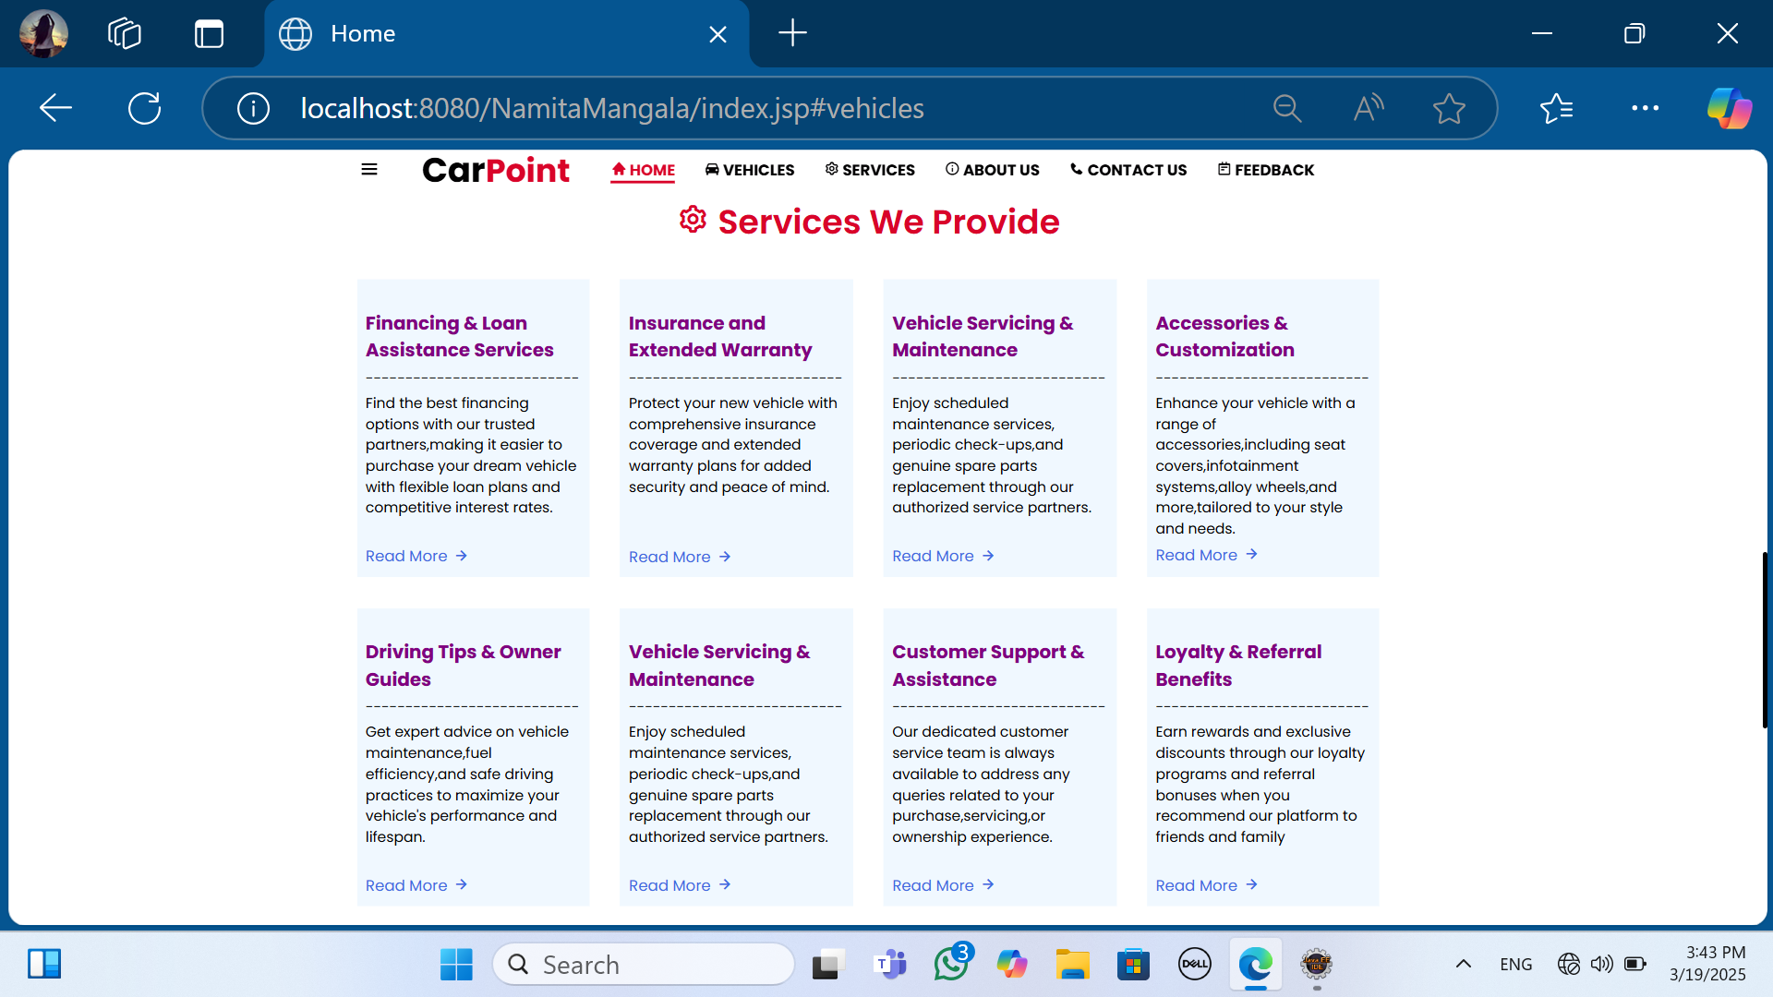
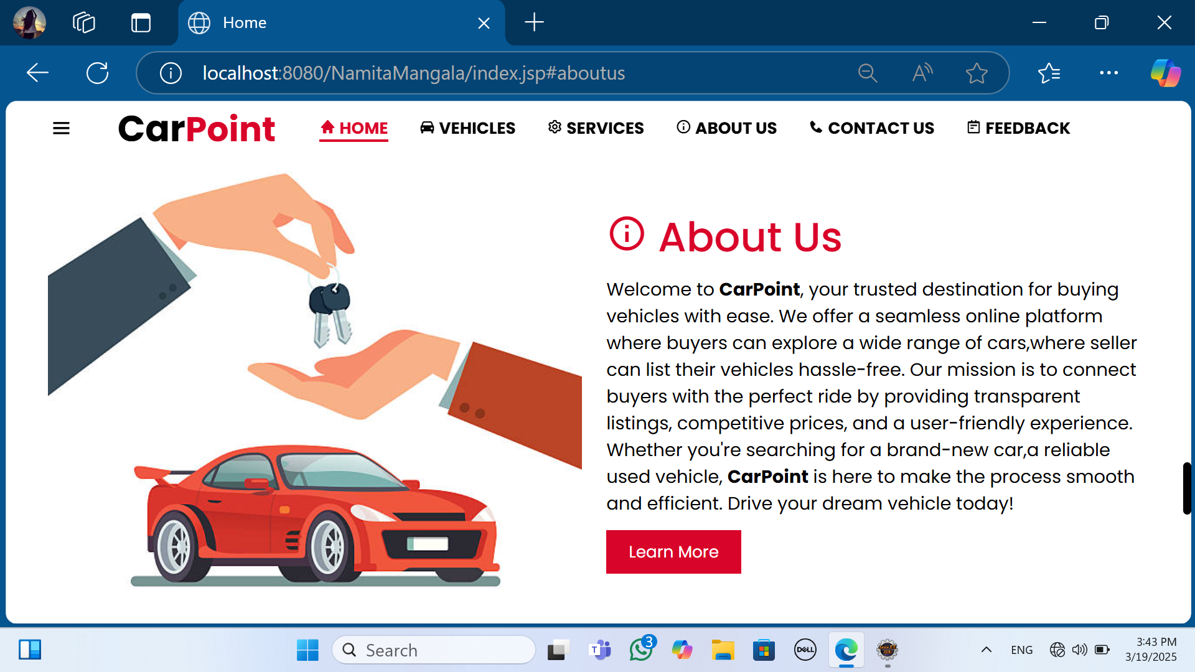
Services and About Us

Slide 23
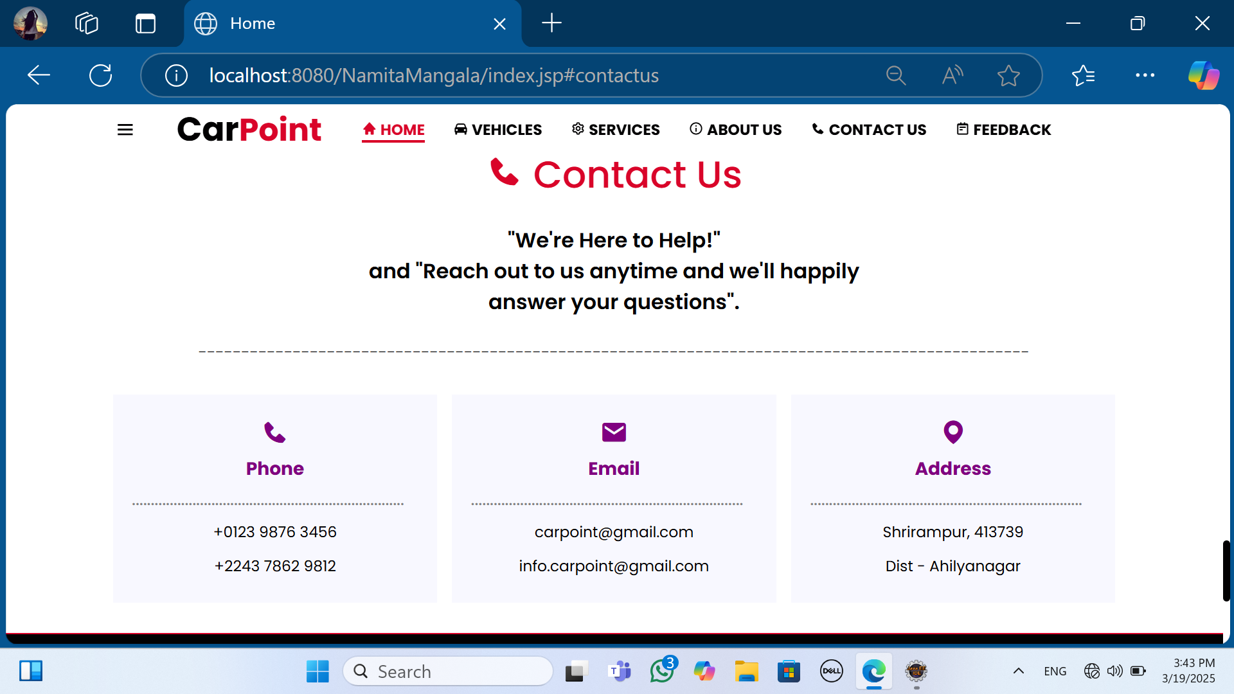
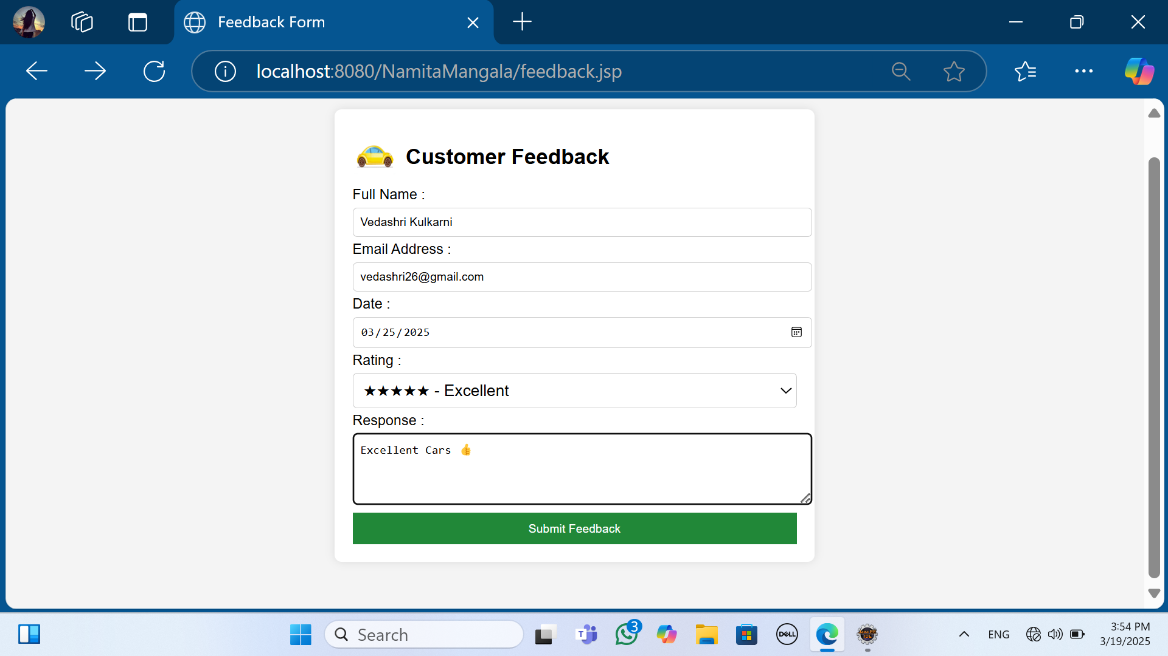
Contact Us and Feedback Form

Slide 24
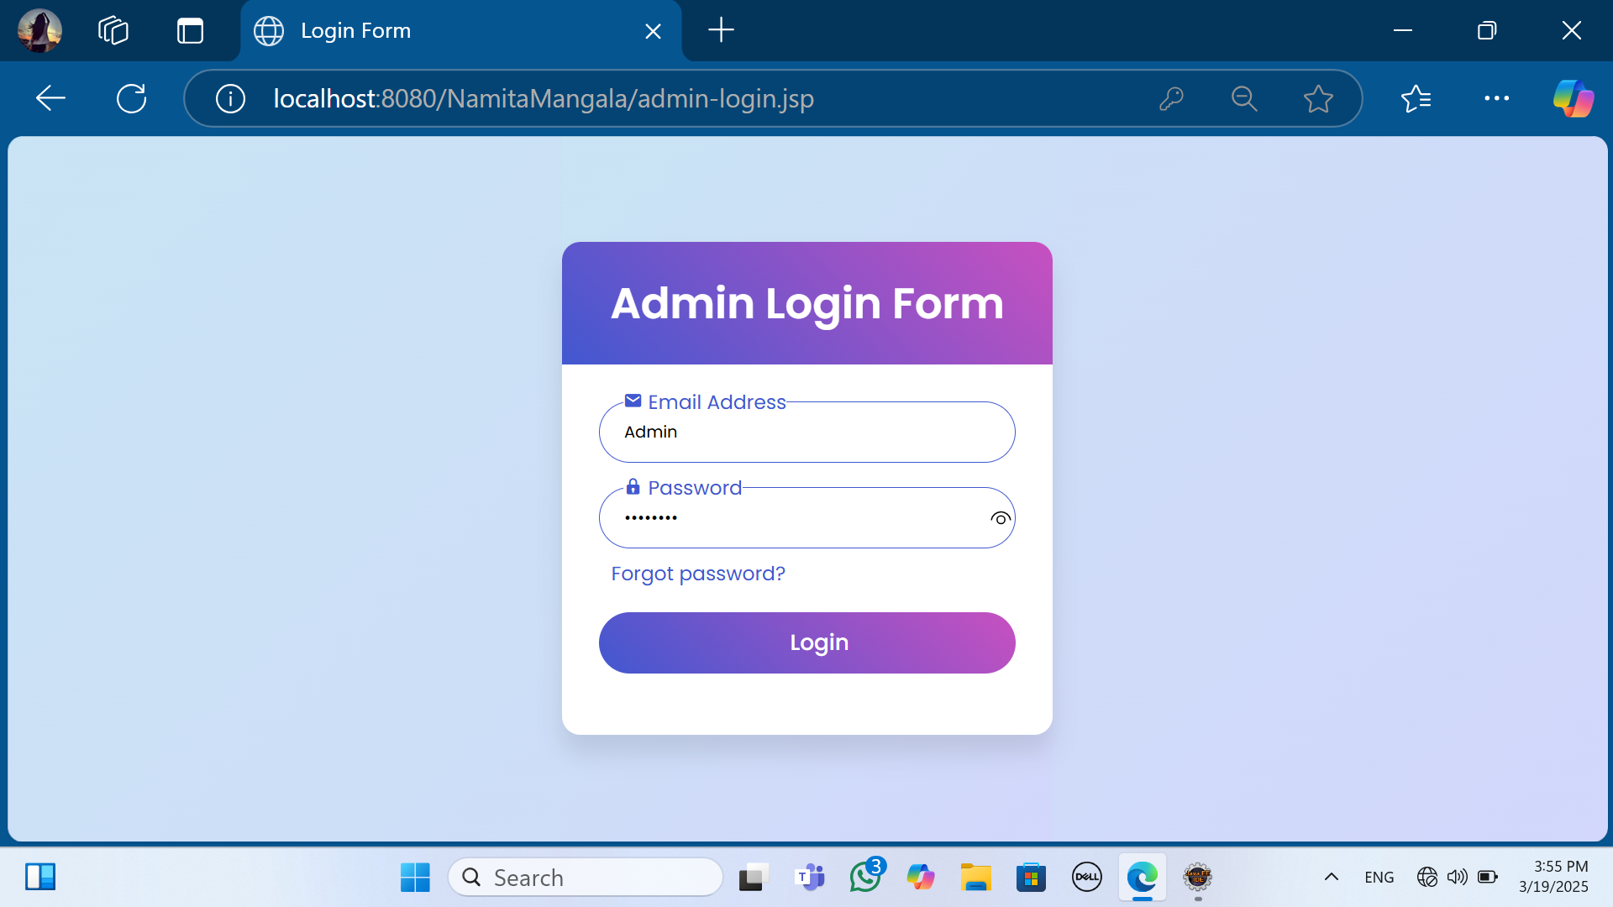
Admin Login Form

Slide 25
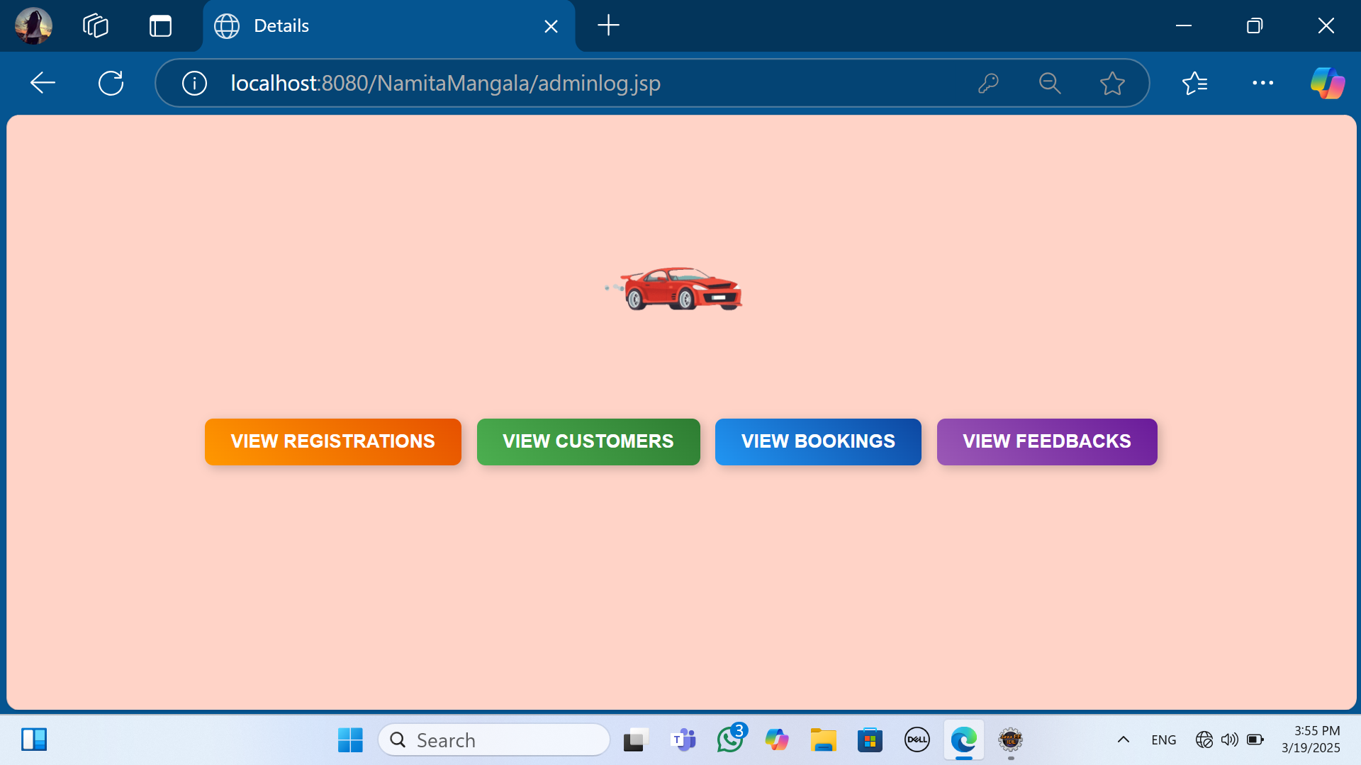
Admin Check

Slide 26
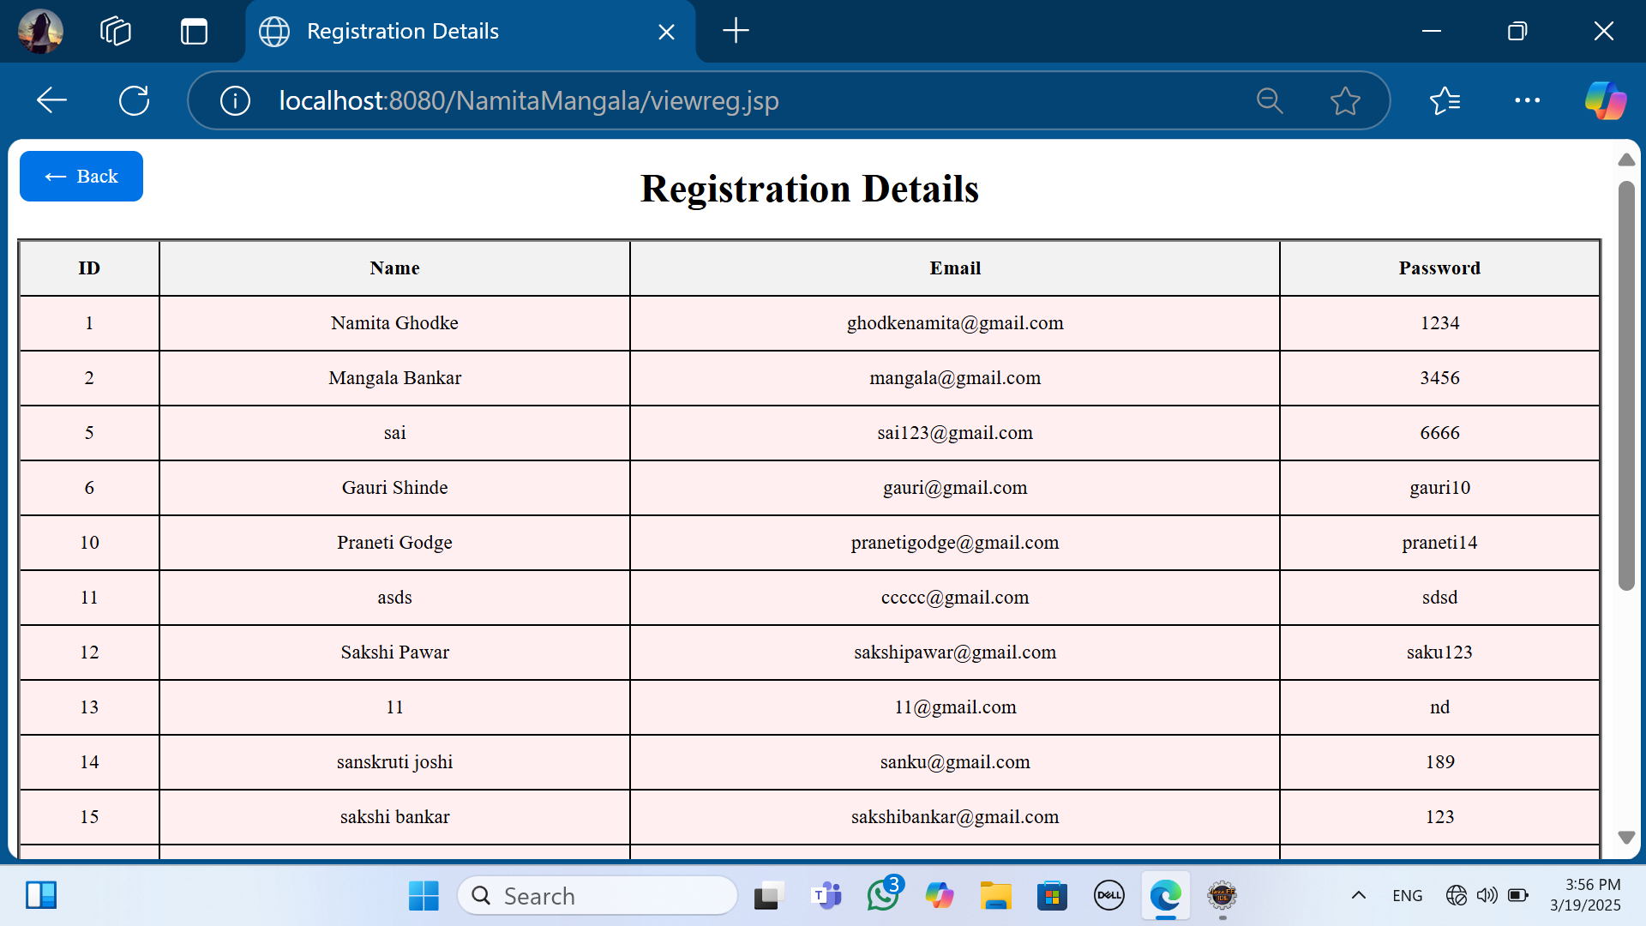
Registration Details

Slide 27
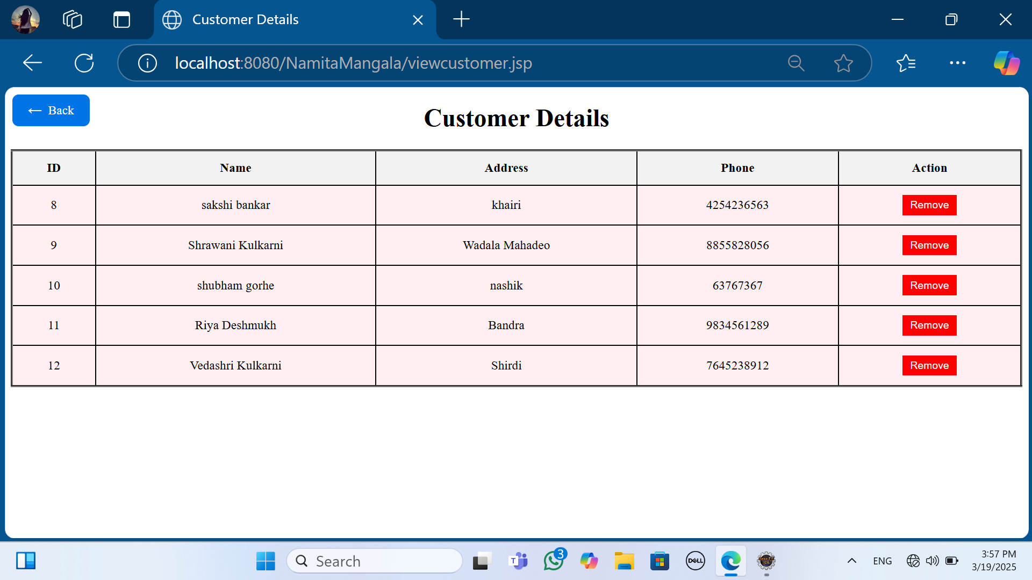
Customer Details

Slide 28
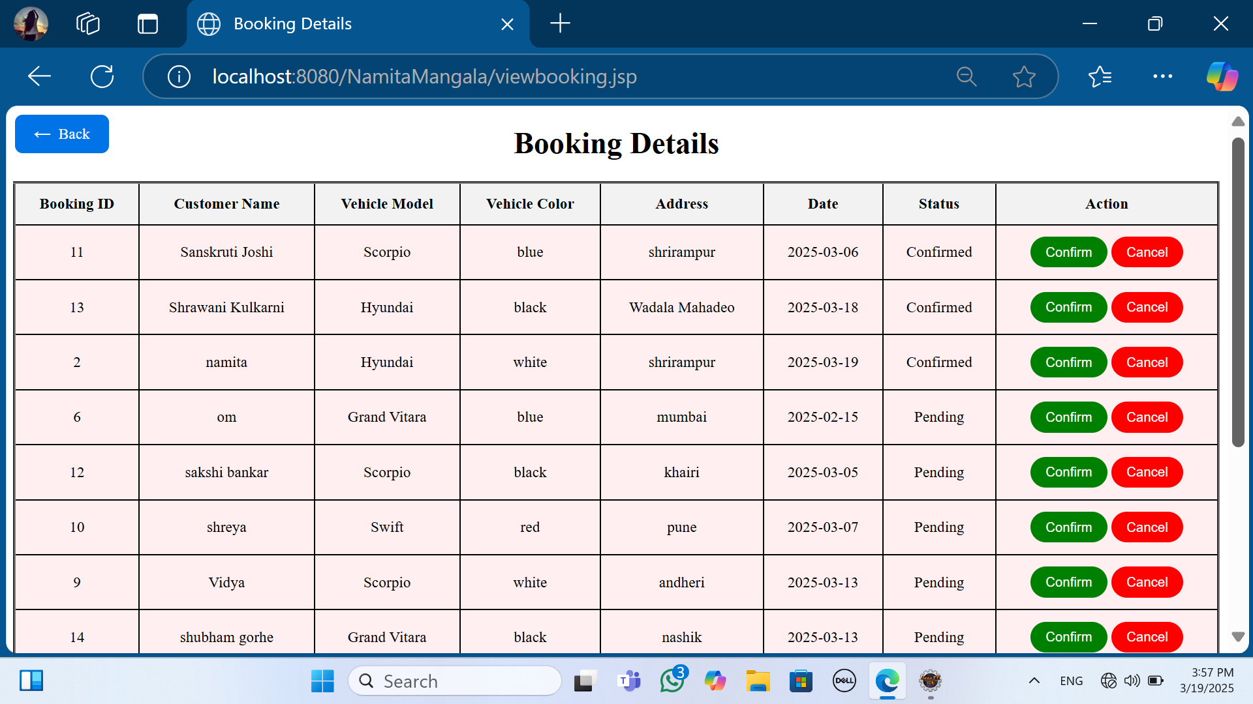
Booking Details

Slide 29
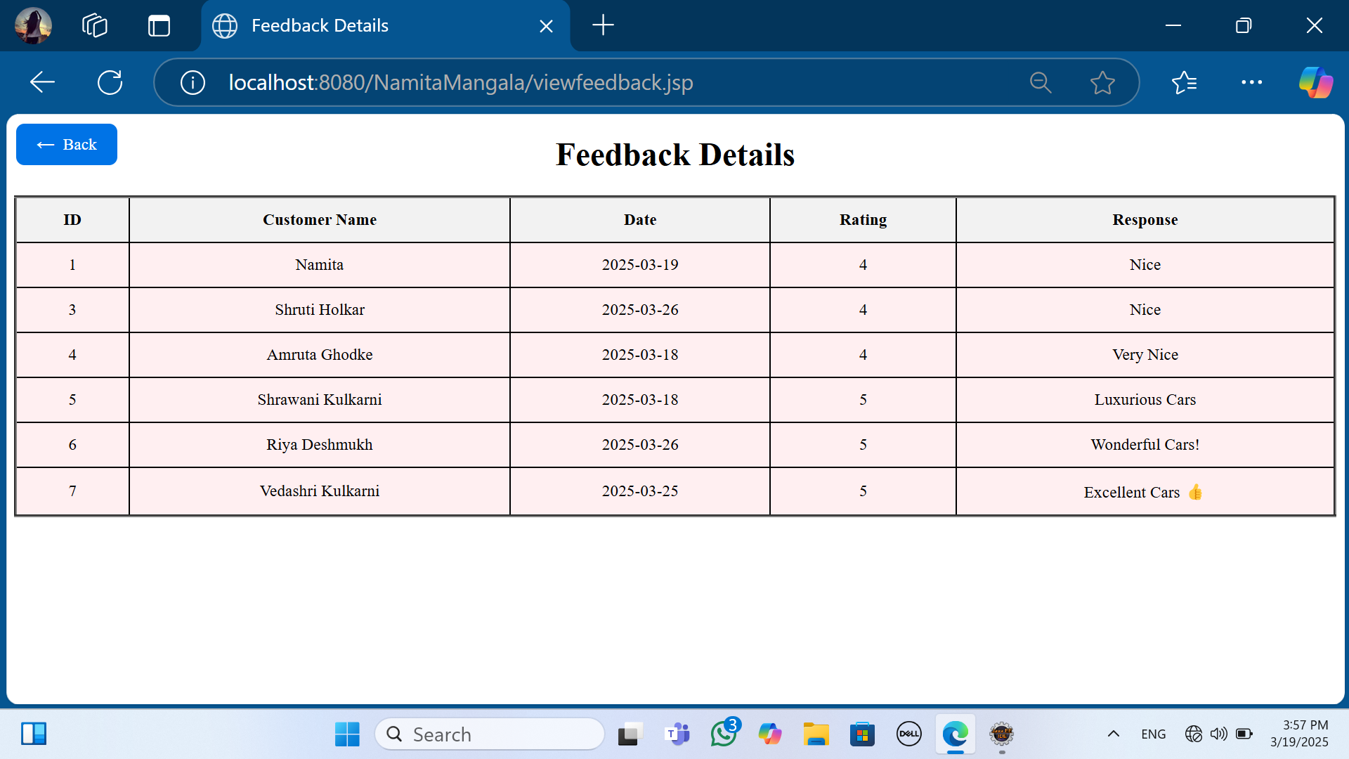
Feedback Details

Slide 30
Future Enhancement
This is not the overall description about the vehicle selling system.
We can connect the sms alert system to the proposed system which will enhance the efficiency of the system.
The email system can be use to connect the user and admin.
Improve Safety with automatic notifications.
Allow test drive for customer.
Provide nearby locations for service stations and also charging points for electric vehicles to new customer in the area.
Provides instance customer support.

Slide 31

Conclusion
This project is design for the purpose to provide a seamless platform for buying and selling vehicles, enhancing user experience through automation, secure transactions, and real-time vehicle information.
Customer can easily book vehicle without wastage of time as per their expectation.In this system Admin or Seller can easily upload the vehicle details and advertise their vehicle by saving the time. Admin can view booking vehicle details, customer details and update the database.

Slide 32

Thank You

